Slide 1
AVR Microcontroller - Part 4 Interrupt Programming
Omid Fatemi

Slide 2
Interrupt Chapter 10

Slide 3
Contents
Polling Vs. interrupt
What is interrupt?
Interrupt unit
Steps in executing an interrupt
Edge trigger Vs. Level trigger in external interrupts
Timer interrupt
Interrupt priority
Interrupt inside an interrupt
Task switching and resource conflict
C programming

Slide 4
Interrupt
The microprocessor does not check if data is available.
The peripheral will interrupt the processor when data is available

Slide 5
Polling Vs. Interrupt
Interrupt
Efficient CPU use
Has priority
Can be masked
main( )
{
Do your common task
}
whenever PIND.2 is 0 then
do something
Polling
Ties down the CPU
while (true)
{
if(PIND.2 == 0)
//do something;
}

Slide 6

Polling vs. Interrupt
instruction
While studying, I’ll check the bucket every 5 minutes to see if it is already full so that I can transfer the content of the bucket to the drum.
Input
Device
Memory
μP
POLLING

Slide 7
Polling vs. Interrupt
instruction
I’ll just study. When the speaker starts playing music it means that the bucket is full. I can then transfer the content of the bucket to the drum.
Input
Device
Memory
Interrupt
request
μP
INTERRUPT

Slide 8
Interrupt
Some terms to remember:
Interrupt service routine
Interrupt vectors
Interrupt vector table

Slide 9
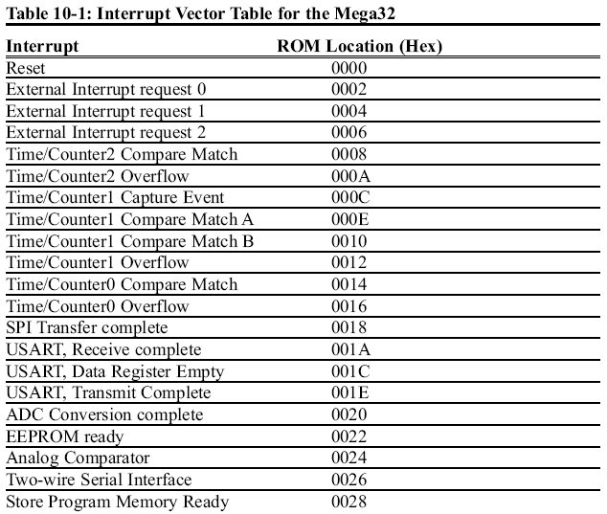
Interrupt unit
Notes:
I: Global Interrupt Enable/Disable Flag
TIMSK; the Timer/Counter Interrupt Mask register
GIMSK General Interrupt Mask register
general interrupt control register (GICR)
The Microcontroller Control Register (MCUCR)
About Store Program Memory:
The Flash memory may be programmed using the Store Program Memory (SPM)
instruction. On devices containing the Self Programming feature the program memory
is divided into two main sections: Application Flash Section and Boot Flash Section.
On devices with boot block, the SPM instruction has the ability to write to the entire
Flash memory, but can only be executed from the Boot section. Executing SPM from
the Application section will have no effect. On the smaller devices that don’ have a
boot block, the SPM instruction can be executed from the entire memory.

Slide 10
Steps in executing an interrupt
Address
Code
PB0
1
2
3
4
5
6
7
8
9
10
11
12
13
14
15
16
17
18
19
20
40
39
38
37
36
35
34
33
32
31
30
29
28
27
26
25
24
23
22
21
VCC
.INCLUDE "M32DEF.INC"
.ORG 0 ;location for reset
JMP MAIN
.ORG 0x02 ;location for external INT0
JMP EX0_ISR
MAIN: LDI R20,HIGH(RAMEND)
OUT SPH,R20
LDI R20,LOW(RAMEND)
OUT SPL,R20
SBI DDRC,3 ;PC.3 = output
SBI PORTD,2 ;pull-up activated
LDI R20,1<<INT0 ;Enable INT0
OUT GICR,R20
SEI ;Set I (Enable Interrupts)
LDI R30, 3
LDI R31, 4
ADD R30, R31
HERE:JMP HERE
EX0_ISR:IN R21,PORTC
LDI R22,0x08
EOR R21,R22
OUT PORTC,R21
RETI
PB1
0002
PA0 (ADC0)
0000 0002 0002 0004 0005 0006 0007 0008 0009 000A 000B 000C 000D 000E 000F 0010 0012 0013 0014 0015 0016
(INT2) PB2
PA1 (ADC1)
(OC0/AIN0) PB3
PA2 (ADC2)
(SS) PB4
ATmega32
PA3 (ADC3)
(MOSI) PB5
PA4 (ADC4)
(MISO) PB6
0012
PA5 (ADC5)
0013
0014
0015
0016
000D
000A
0009
000C
000B
0008
0006
000F
000E
0004
0007
0005
PC:
0000
(SCK) PB7
PA6 (ADC6)
RESET
PA7 (ADC7)
VCC
AGND
GND
AVCC
XTAL2
PC7 (TOSC2)
XTAL1
PC6 (TOSC1)
00
(RXD) PD0
PC5 (TDI)
0F
(TXD) PD1
SP
PC4 (TDO)
(INT0) PD2
PC3 (TMS)
(INT1) PD3
PC2 (TCK)
(OC1B) PD4
Stack
PC1 (SDA)
(OC1A) PD5
PC0 (SCL)
(ICP) PD6
PD7 (OC2)

Slide 11
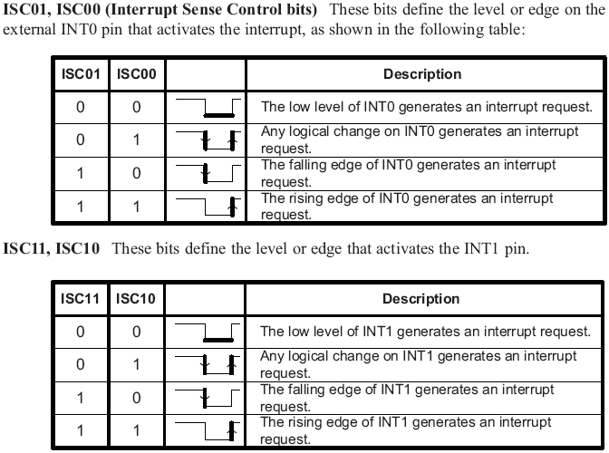
Edge trigger Vs. Level trigger in external interrupts
LDI R20,0x02 ;falling
OUT MCUCR,R20

Slide 12
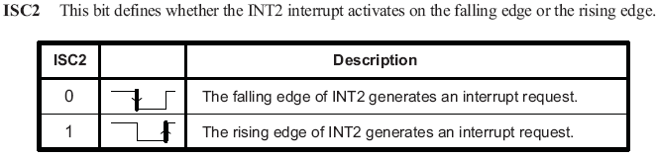
Edge trigger Vs. Level trigger (Cont.)

Slide 13
Using Timer0 overflow interrupt
This program uses Timer0 to generate a square wave on pin PORTB.5, while at the same time data is being transferred from PORTC to PORTD.
Timer int.
init.
1
2
3
4
5
6
7
8
9
10
11
12
13
14
15
16
17
;Program 10-1
.INCLUDE "M32DEF.INC"
.ORG 0x0 ;location for reset
JMP MAIN
.ORG 0x16 ;loc. for Timer0 over.
JMP T0_OV_ISR
;----main program for initialization
.ORG 0x100
MAIN: LDI R20,HIGH(RAMEND)
OUT SPH,R20
LDI R20,LOW(RAMEND)
OUT SPL,R20
SBI DDRB,5 ;output
LDI R20,0
OUT DDRC, R20
LDI R20,0xFF
OUT DDRD, R20
18
19
20
21
22
23
24
25
26
27
28
29
30
31
32
33
34
LDI R20,(1<<TOIE0)
OUT TIMSK,R20
SEI
LDI R20,-32 ;value for 4µs
OUT TCNT0,R20
LDI R20,0x01
OUT TCCR0,R20
HERE: IN R20,PINC
OUT PORTD,R20
JMP HERE
;--------ISR for Timer 0
T0_OV_ISR:
IN R16,PORTB
LDI R17,0x20
EOR R16,R17
OUT PORTB,R16
RETI
Timer init.
Notes:
TOIE0: Timer overflow interrupt enable 0

Slide 14
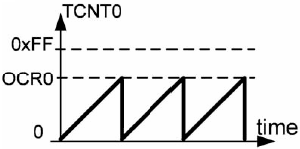
Timer0 compare match interrupt
using Timer0 and CTC mode generate a square wave on pin PORTB.5, while at the same time data is being transferred from PORTC to PORTD.
.INCLUDE "M32DEF.INC"
.ORG 0x0 ;location for reset
JMP MAIN
.ORG 0x14 ;location for Timer0 compare match
JMP T0_CM_ISR
;-main program for initialization and keeping CPU busy
.ORG 0x100
MAIN: LDI R20,HIGH(RAMEND)
OUT SPH,R20
LDI R20,LOW(RAMEND)
OUT SPL,R20
LDI R20,39
OUT OCR0,R20 ;OCR0 = 39
LDI R20,0x09
OUT TCCR0,R20 ;Start Timer0
SBI DDRB,5 ;PB5 as an output
LDI R20,(1<<OCIE0) ;Timer0 compare match
OUT TIMSK,R20
SEI ;Set I
LDI R20,0x00
OUT DDRC,R20 ;make PORTC input
LDI R20,0xFF
OUT DDRD,R20 ;make PORTD output
Time (µS)
HERE: IN R20,PINC
OUT PORTD,R20
JMP HERE
;--------ISR for Timer 0
T0_CM_ISR:
IN R16,PORTB
LDI R17,0x20
EOR R16,R17
OUT PORTB,R16
RETI
Timer init.
Timer int.
init.

Slide 15
Interrupt priority
Highest priority
Lowest priority

Slide 16
Interrupt inside an interrupt
The I flag is cleared when the AVR begins to execute an ISR. So, interrupts are disabled.
The I flag is set when RETI is executed.

Slide 17
Task switching and resource conflict
Does the following program work?
1
2
3
4
5
6
7
8
9
10
11
12
13
14
15
16
.INCLUDE "M32DEF.INC"
.ORG 0x0 ;location for reset
JMP MAIN
.ORG 0x14 ;Timer0 compare match
JMP T0_CM_ISR
;---------main program------------------------------
.ORG 0x100
MAIN: LDI R20,HIGH(RAMEND)
OUT SPH,R20
LDI R20,LOW(RAMEND)
OUT SPL,R20 ;set up stack
SBI DDRB,5 ;PB5 = output
LDI R20,160
OUT OCR0,R20
LDI R20,0x09
OUT TCCR0,R20
17
18
19
20
21
22
23
24
25
26
27
28
29
30
31
32
LDI R20,(1<<OCIE0)
OUT TIMSK,R20
SEI
LDI R20,0xFF
OUT DDRC,R20
OUT DDRD,R20
LDI R20, 0
HERE: OUT PORTC,R20
INC R20
JMP HERE
;--------------------------ISR for Timer0
T0_CM_ISR:
IN R20,PIND
INC R20
OUT PORTD,R20
RETI

Slide 18
Solution 1: different registers
Use different registers for different tasks.
1
2
3
4
5
6
7
8
9
10
11
12
13
14
15
16
.INCLUDE "M32DEF.INC"
.ORG 0x0 ;location for reset
JMP MAIN
.ORG 0x14 ;Timer0 compare match
JMP T0_CM_ISR
;---------main program------------------------------
.ORG 0x100
MAIN: LDI R20,HIGH(RAMEND)
OUT SPH,R20
LDI R20,LOW(RAMEND)
OUT SPL,R20 ;set up stack
SBI DDRB,5 ;PB5 = output
LDI R20,160
OUT OCR0,R20
LDI R20,0x09
OUT TCCR0,R20
17
18
19
20
21
22
23
24
25
26
27
28
29
30
31
32
LDI R20,(1<<OCIE0)
OUT TIMSK,R20
SEI
LDI R20,0xFF
OUT DDRC,R20
OUT DDRD,R20
LDI R20, 0
HERE: OUT PORTC,R20
INC R20
JMP HERE
;--------------------------ISR for Timer0
T0_CM_ISR:
IN R21,PIND
INC R21
OUT PORTD,R21
RETI

Slide 19
Solution 2: Context saving
Save the contents of registers on the stack before execution of each task, and reload the registers at the end of the task.
1
2
3
4
5
6
7
8
9
10
11
12
13
14
15
16
17
.INCLUDE "M32DEF.INC"
.ORG 0x0 ;location for reset
JMP MAIN
.ORG 0x14 ;Timer0 compare match
JMP T0_CM_ISR
;---------main program------------------------------
.ORG 0x100
MAIN: LDI R20,HIGH(RAMEND)
OUT SPH,R20
LDI R20,LOW(RAMEND)
OUT SPL,R20 ;set up stack
SBI DDRB,5 ;PB5 = output
LDI R20,160
OUT OCR0,R20
LDI R20,0x09
OUT TCCR0,R20
LDI R20,(1<<OCIE0)
18
19
20
21
22
23
24
25
26
27
28
29
30
31
32
33
34
OUT TIMSK,R20 SEI
LDI R20,0xFF
OUT DDRC,R20
OUT DDRD,R20
LDI R20, 0
HERE: OUT PORTC,R20
INC R20
JMP HERE
;--------------------------ISR for Timer0
T0_CM_ISR:
PUSH R20 ;save R20
IN R20,PIND
INC R20
OUT PORTD,R20
POP R20 ;restore R20
RETI

Slide 20
Saving SREG
We should save SREG, when we change flags in the ISR.
PUSH R20
IN R20,SREG
PUSH R20
...
POP R20
OUT SREG,R20
POP R20

Slide 21
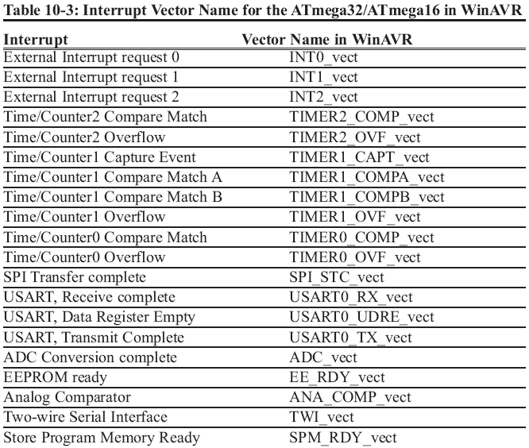
C programming
Using Timer0 generate a square wave on pin PORTB.5, while at the same time transferring data from PORTC to PORTD.
#include "avr/io.h"
#include "avr/interrupt.h"
int main ()
{
DDRB |= 0x20; //DDRB.5 = output
TCNT0 = -32; //timer value for 4 µs
TCCR0 = 0x01; //Normal mode, int clk, no prescaler
TIMSK = (1<<TOIE0); //enable Timer0 overflow interrupt
sei (); //enable interrupts
DDRC = 0x00; //make PORTC input
DDRD = 0xFF; //make PORTD output
while (1) //wait here
PORTD = PINC;
}
ISR (TIMER0_OVF_vect) //ISR for Timer0 overflow
{
TCNT0 = -32;
PORTB ^= 0x20; //toggle PORTB.5
}
sei ( ); //set I
cli ( ); //clear I

Slide 22
C programming Example 2
Using Timer1 and CTC mode write a program that toggles pin PORTB.5 every second, while at the same time transferring data from PORTC to PORTD. Assume XTAL = 8 MHz.
#include "avr/io.h"
#include "avr/interrupt.h"
int main ()
{
DDRB |= 0x20; //make DDRB.5 output
OCR0 = 40;
TCCR0 = 0x09; //CTC mode, internal clk, no prescaler
TIMSK = (1<<OCIE0); //enable Timer0 compare match int.
sei (); //enable interrupts
DDRC = 0x00; //make PORTC input
DDRD = 0xFF; //make PORTD output
while (1) //wait here
PORTD = PINC;
}
ISR (TIMER0_COMP_vect) //ISR for Timer0 compare match
{
PORTB ^= 0x20; //toggle PORTB.5
}

Slide 23
C programming Example 3
Assume that the INT0 pin is connected to a switch that is normally high. Write a program that toggles PORTC.3, whenever INT0 pin goes low. Use the external interrupt in level-triggered mode.
#include "avr/io.h"
#include "avr/interrupt.h"
int main ()
{
DDRC = 1<<3; //PC3 as an output
PORTD = 1<<2; //pull-up activated
GICR = (1<<INT0); //enable external interrupt 0
sei (); //enable interrupts
while (1); //wait here
}
ISR (INT0_vect) //ISR for external interrupt 0
{
PORTC ^= (1<<3); //toggle PORTC.3
}

